Slide 1

LOAN
ORIENTATION

Slide 2
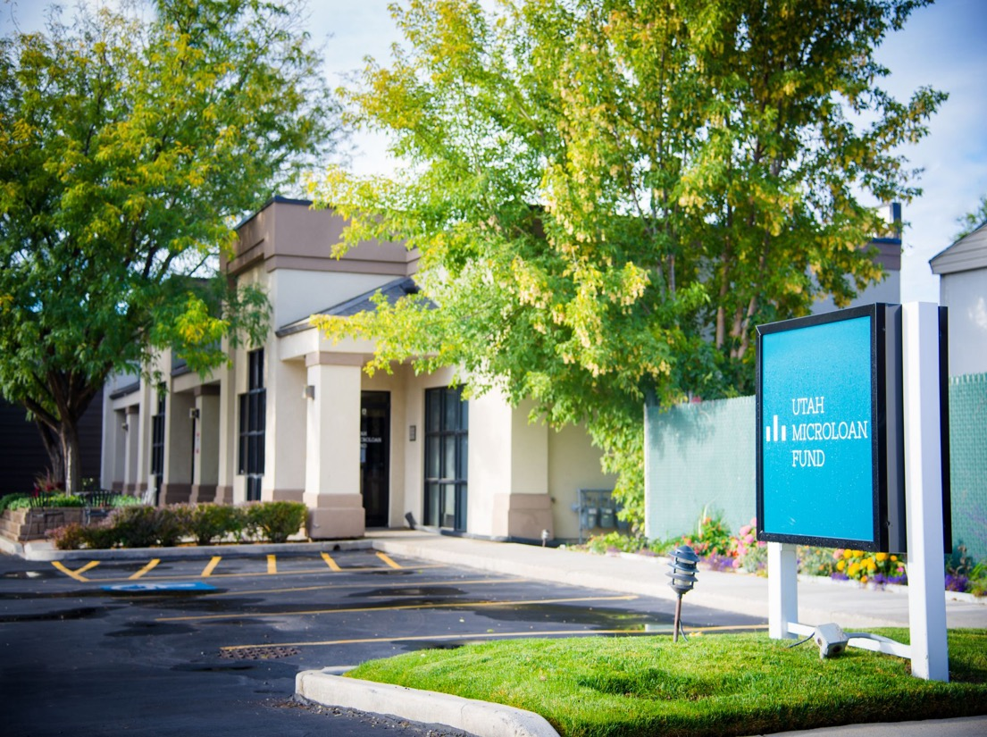
Welcome to Orientation!
This slide presentation has been prepared to familiarize you with the Utah Microloan Fund, our process and the requirements to apply for a loan.
To facilitate the process and move forward as smoothly as possible, please review these slides carefully.
We look forward to working with you! ☺

Slide 3
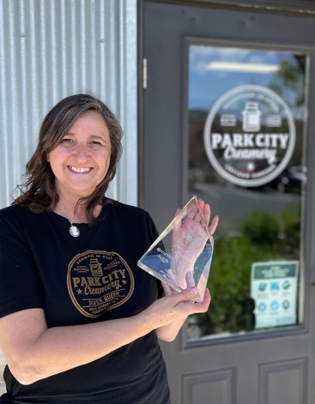
Who Are We?
We are a non-profit lending institution that offers microloans to small businesses unable to get traditional bank financing. For over 30 years, we’ve been helping people realize their dreams of starting and growing their own businesses.
We invest more than just money in our borrowers. We provide them with group classes and one-on-one business training to help them succeed. When our borrowers succeed, our local communities grow and thrive.
Located in Salt Lake City, we serve the entire state of Utah.
Our Mission
To support small business owners across Utah by providing training and microloans to start-up and existing businesses that are not eligible for traditional financing.
Corinne Zinn of Park City Creamery
3

Slide 4
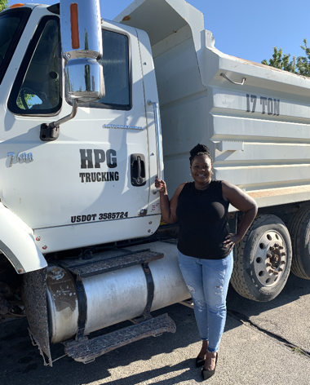
How are we
funded?
As a Community Development Financial Institution (CDFI) lender we leverage investments and grants from financial institutions, foundations, government agencies like the SBA, other non-profits, etc. to provide capital and training to our borrowers. Together with these funders, we serve small businesses and their communities throughout the state.
To learn more about Community Development Financial Institution’s visit What is a CDFI?
Lakasha Hodges of HPG Trucking
4

Slide 5
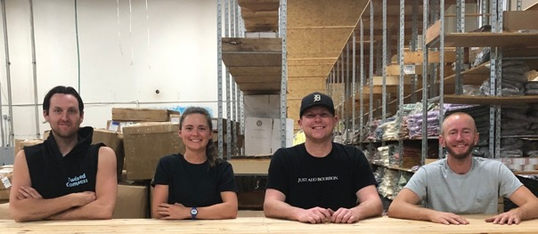
Who
Qualifies?
We help people who have:
Credit history issues
Insufficient collateral for a traditional loan
A new business without operating history
Been turned down by a bank
PackYak Fulfillment
We cannot fund:
MLM’s
Real estate purchases
Lending businesses
Nonprofit businesses
Individuals who are in an active bankruptcy
Businesses not registered in the state of Utah
5

Slide 6
What is Loan Approval Based On?
The viability of the business as demonstrated in the business plan.
The reality of the cash flow forecast.
The character of the individual.
6

Slide 7

Funding Structure
How Long Have You Been in Business
The primary determining factor when considering maximum loan request is length of time in business.
Year 1 in Business
Up to $25,000
Often initial funding around $10K+/- with possible follow up within first year
Year 2 in Business
Up to $50,000
Year 3 in Business
Up to $100,000
Year 3+ Established Business
May qualify for funding above $100,000

Slide 8
Our Loan Terms
Interest Rates
Rates are currently between 10 -15%.
In partnership with the Utah Assistive Technology Foundation, we also offer discounted rates for Utahns with disabilities.
There are no prepayment penalties.
Length of Loan
Loan term up to a maximum term of 5 years (60 months)
Disbursement of Funds
We disburse funds on an as-needed basis and don’t typically release the full amount of your loan at closing. As an SBA microlender we have specific audit conditions that require that we keep detailed records of each use of funds that are as close as possible to the ones you will list in your application.
8

Slide 9

LOAN FEES
Origination fees are deducted from the loan proceeds.
Be sure to consider this in your Use of Funds.
3-6%
Origination Fee
: 3-6% of the total loan amount. This fee is not paid upfront but is deducted from the loan amount.
$50
Application Fee
(Must be paid before your applicable will be considered)
$10,000 loan over 5 years
Loan Origination Fee: $300
Total Fees: $300
Funds available to use: $9,700
9

Slide 10
EXAMPLE LOAN TERMS
Principal to interest breakdown will change every month, you will pay the most interest at the beginning, and the least at the end.
Assuming you stay on the amortization schedule you will never make an interest-only payment.
$10,000.00 loan over 5 years at 11%
Loan Origination Fee: $300.00 (5%)
Total Fees: $300.00
Funds available to use: $9,700.00
Monthly payment: $218.81
$50,000.00 loan over 6 years at 12%
Loan Origination Fee: $1,500.00 (3%)
Total Fees: $1,500.00
Funds available to use: $49,500.00
Monthly payment: $977.51
10

Slide 11
Our Loan Process
Complete loan orientation. Our orientations are held every Tuesday at 9am virtually. A Spanish version of the slides is also available online.
Step One
Fill out an inquiry form. This form includes information about you, your business, and the funding you are looking for. If everything is good to go, we will then add you to Lenderfit, our online application system.
Step Two
Step Three
Submit a Business Plan: We would like you to work with an advisor on the business plan and submit it before you start the bulk of the application. This will allow us to see if there needs to be any adjustments to the business before you start the bulk of the application.
Step Four
Complete Your Application: In Lenderfit, you will submit your application and supporting documents including tax returns, financial info., cashflow, etc. You will work with your advisor in this step, too. The main forms we want them to help with are the business plan, cash flow projection, and use of funds. This step also includes a $50 application fee paid either by check, cash, or online.
Present to our team. Once your application is complete you will then get a chance to present your business and funding request to our team. We will set up a date for you to present virtually via Zoom.
Step Five
If approved, you will typically close your loan in approximately one-two weeks. You will then submit your necessary closing documents we need in order to get your funds.
Step Six
11

Slide 12

The Application
For a start-up you will need to:
Meet with an advisor.
Prepare a Business Plan & 12-month Cash Flow projection using our provided templates.
Submit past 3 years of personal tax returns.
Submit past 3 months of personal checking statements.
Submit EIN letter, articles of organization , & business registration in the state of Utah.
Submit proof of citizenship & identification birth certificate, passport, U.S. driver’s license with your Social Security Card, etc. for ALL owners.
Pay the $50 application fee either online or by mailing or dropping off a check to our office located at 154 E Ford Ave Ste A, Salt Lake City, UT 84115, paid to Utah Microloan Fund.
12

Slide 13

The Application
For an existing business you will need:
Everything on the last slide +
Submit past 3 years of business tax returns including K-1’s.
Submit past 3 months of business checking statements.
Year to Date Profit and Loss Statement
Financial statements for past 3 years for existing businesses (income statement and balance sheet)
13

Slide 14

The Application
Things to Note:
Any co-owners with 20% or more ownership will fill out a separate co-owner application. Please let us know if you have any co-owners asap so we can get them started as well! ($50 fee is per business)
Please make sure you don’t have any freezes on your credit during the application process as we do pull your credit.
You will need to meet with a business advisor. You can use one of your own or we can refer you to one.
Our Loan Officer and underwriter will work with you and make suggestions to improve your application, give feedback, well as ask clarifying questions. They may also request additional documentation.
Once all questions are answered and all documents are submitted you will be scheduled on the next loan committee to present your business!
Monsieur Crepes
14

Slide 15

Presenting
This is your chance to meet with our team and show that you are ready and prepared to make your business succeed!
You will present your business within 7-10 minutes followed by about 10 minutes of questions (20-25 min.).This is an informal(ish) presentation.
Held twice a month. We can accommodate 7-8 applications per month
Their questions will be direct but they are always respectful – they want to make sure you are ready to start your business!
Topics to speak to during your presentation may be: why you want to start this business, your background or story, how the loan will help you grow/succeed, your numbers.
We will then reach out with our decision within a few days.
15

Slide 16
Post Approval
Checklist
    You will need to submit:
    If Requested:
Proof of business liability insurance, adding the UMLF as “loss payee”
Copies of invoices, purchase orders, etc. for any use of funds
Names and amounts of checks to vendors/suppliers/contractors
ACH Authorization
Voided check
Home as Collateral:
    Copy of the trust deed (document containing the legal description)
    Proof of insurance on the property
    Co-Signer:
                Completed co-signor application
                Copies of the last two years of personal tax returns
16

Slide 17
Your business plan does not seem well thought out.
Intentional attempts at covering up or hiding information
1
2
The Most Common Reasons for Decline
Lack of research to understand the market.
Failure to acknowledge competition.
You don’t understand your own numbers.
Credit report shows you have never paid a bill on time.
3
4
5
6

Slide 18
Business Plan: The Basics
The business plan should be max
5 – 10 pages.
Avoid charts and graphs unless they are relevant to your business.
Focus on main points in bullet form using your own words.
Location photos and examples of products can also be helpful when applicable.
Use the format provided. The sections of the Business Plan are in bold.
Your Use of Funds should be detailed, specific, and match your cashflow projections.
18

Slide 19
Estimating Startup Costs
Office space (rent and utilities)
Lawyer and accountant
Equipment and supplies
Inventory
Licenses and permits
Employee salaries
Insurance
Advertising and marketing (including website design)
19

Slide 20




Need help with your
business plan & cashflow?
Here are some great resources that offer advising and can assist if you need extra help with your business.
Small Business Development Centers
www.utahsbdc.org
Women’s Business Center
(801) 328-5066
https://wbcutah.org/
SCORE
(801) 957-5453
www.score.org
20

Slide 21

Class is
In Session
Whether you are just starting out or are trying to take your business to the next level, we've got you covered.
Our class topics rotate between the essentials we think will make you the best business owner you can be including:
Financials
Social Media & Marketing
Business Strategy & Planning
Hiring - and so much more.
Our classes are always free and open to the public and our live classes are hosted virtually so all can attend.
Increasing access to knowledge throughout our different communities means a more powerful Utah together.
Learn more here: www.utahmicroloanfund.org/upcomingclasses
21

Slide 22
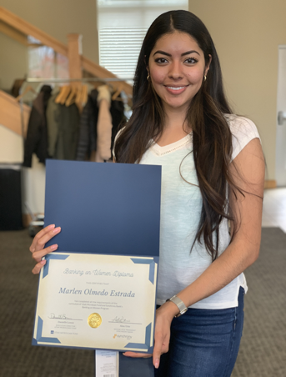
Banking On Women
A dedicated program to empowering women in Utah to start or grow their own small business, ten years running! Thanks to the generosity of Synchrony, this program is free to participants.
​The curriculum covers all aspects of running a small business including business planning, market research, marketing, financial management, growth, and leadership.
Virtual Cohort for Rural Utahns
In-person Cohort for Salt Lake City
Held twice a year in Spring & Fall
Learn more at www.utahmicroloanfund.org/bankingonwomen
22

Slide 23

We can’t wait to work with you!

